Slide 1

Customizing Blogengine.net Level: 200
St. Louis Day of .NET - 2011

Slide 2
Contact Information
Geeks with Blogs - geekswithblogs.net/scottkuhl/
Twitter - @scottkuhl
Google - profiles.google.com/scottkuhl/
Email – scott@kuhl.ws

Slide 3
Overview
What is BlogEngine.NET
Setup and Configuration
Creating a Custom Theme
Creating a Custom Control
Creating a Custom Widget
Creating a Custom Extension
Publishing
Hosting
SEO

Slide 4
BlogEngine.NET
“BlogEngine.NET is an open source .NET blogging project that was born out of desire for a better blog platform. A blog platform with less complexity, easy customization, and one that takes advantage of the latest .NET features.”

Slide 5
Features
Multiple author support
Multiple blog support (new in version 2.5)
Tracking statistics
Third party comment system integration
Moderation and spam controls
Desktop software support
Notes:
Tracking
Basic: Posts, Pages, Comments (Unapproved & Spam), Categories, Tags, Users
More Useful: Pingbacks, Trackbacks, Referrers
Third Party Comments
Avatars: MonsterID, Wavatar, Identicon
Disqus
Moderation
Comments must be approved option.
White list rules for multiple approvals or by IP.
Black list rules for offenders.
Spam
Filters: AkismetFilter, StopForumSpam, TypePadFilter
Captcha: Recaptcha, SimpleCaptcha
Desktop
Windows Live Writer
Anything that supports the MetaWeblog API

Slide 6
Features (cont.)
Custom pages
Custom controls and widgets
Custom themes
Custom extensions
Notes:
You can download the source can change anything.
TIP: Keep track of all the changes you make in a text file. Useful when upgrading.

Slide 7
BlogEngine vs. WordPress
BlogEngine
.NET
WordPress
Much larger user base
Lots of custom themes
Many more extensions and widgets
Notes:
Much of BlogEngine community is old and stale.
Version 2 is bringing new life.

Slide 8


On The Web
Official Site
www.dotnetblogengine.net
CodePlex
blogengine.codeplex.come

Slide 9
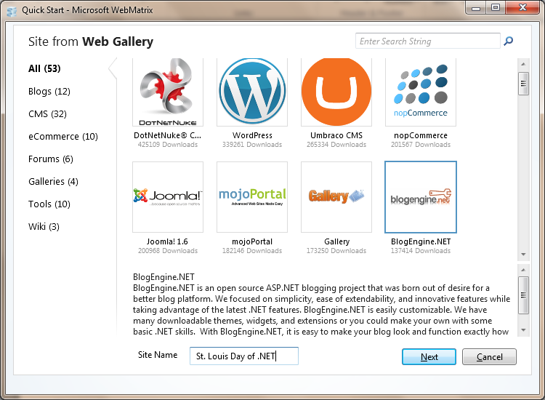
WebMatrix
Easy
Integrated WebPI
Dependency Checking
Notes:
Missing Features
Intellisense
Debugging
Errors during the build will produce junk output. Build the site in Visual Studio to find the problem
DEMO
Open WebMatrix
Create a new site using the Gallery

Slide 10
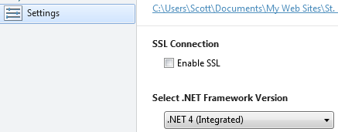
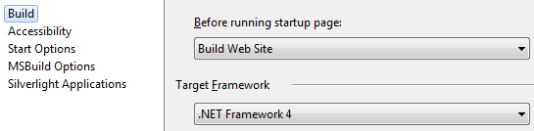
ASP.NET 4.0 for v2
WebMatrix
Visual Studio
Notes:
DEMO
Show value in WebMatrix
Show value in Visual Studio

Slide 11
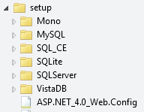
ASP.NET 4.0 for v2 (cont.)
Replace Web.config with 4.0 version in the setup folder.
Notes:
DEMO
Show file in WebMatrix

Slide 12
Data Storage
XML (default)
SQL Server (Compact, Express, Full)
Non-Microsoft (MySQL, SQLite, Vista DB)
Notes:
I prefer SQL Compact because its easy to setup and has a nice upgrade path to Express and then full versions of SQL Server.
Also makes a good development database since you don’t need to install a server grade database on your workstation.
Ruby on Rails developers have been using a similar technique for years.

Slide 13

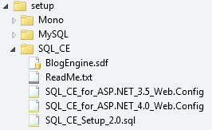
SQL Server Compact 4
Copy SQL files to the bin folder
C:\Program Files (x86)\Microsoft SQL Server Compact Edition\v4.0\Private
Replace Web.Config
Copy BlogEngine.sdf to App_Data
Notes:
DEMO
Show files in the bin folder
Show files in App_Data
Show config file in setup folder

Slide 14
XML File Cleanup
Delete XML files and folders from App_Data
Update Web.config, remove:
<add name="XmlBlogProvider" …/>
<add name="XmlMembershipProvider" …/>
<add name="SqlMembershipProvider" …/>
<add name="XmlRoleProvider" …/>
<add name="SqlRoleProvider" …/>
Notes:
DEMO
Show settings from same config file on the previous slide

Slide 15
Themes
Located in the themes folder
Each theme has its own sub folder
Download a theme from the gallery
Download a theme from admin (new v2.5)
Copy an existing theme folder
Copy any HTML based template from the web
Download a WordPress template
Notes:
Gallery: dotnetblogengine.net under themes
HTML templates: oswd.org
Wordpress templates: thethemelist.com (not free) or download wordpress
Wordpress tip: The easy way to get the markup and avoid dealing with php is to just run a wordpress site with the template you want and copy the source html generated.

Slide 16
Theme Files
Master Page (site.master)
Post View User Control (PostView.ascx)
Comment View User Control (CommentView.ascx)
Widget User Control (WidgetContainer.ascx)
Newsletter Page (newsletter.html)
Theme Admin Settings (theme.xml, theme.png) (2.5)
Notes:
Master Page: Overall site layout, usually requires the most work
Post View: The post as rendered on a post page or the main page.
Comment View: Comments below a post.
Widget Container: Wrapper around each widget.
Newsletter: Sent as email to subscribers.
Theme Admin: Shows up as a list of installed themes in 2.5.

Slide 17
Theme Master Page Header
Included: RSS/Atom links, Open Search, Core JavaScript, Meta data
You Add: Style Sheets, Favicons, Additional JavaScript
<%@ Import Namespace="BlogEngine.Core" %>
Notes:
Open Search: search box found in Firefox and older version of IE.
Core JavaScript: Auto links to the JavaScript files found in the scripts folder.
Meta:
keywords from tags and categories
description from excerpt
author
semantic web tags

Slide 18
Theme Master Page Body
Typical: Header, Navigation, Posts, Widgets, Footer
<asp:ContentPlaceHolder ID="cphBody" runat="server" />
<blog:WidgetZone runat="server" ZoneName="be_WIDGET_ZONE" />
Notes:
Content placer holder is for posts and comments
Widget zone is for widgets
DEMO
Show sections of site.master

Slide 19
Theme Blog Settings
Name <%=BlogSettings.Instance.Name %>
Description <%=BlogSettings.Instance.Description %>
Email <%=BlogSettings.Instance.Email %>
Theme <%=BlogSettings.Instance.Theme %>
Version <%=BlogSettings.Instance.Version() %>
Notes:
DEMO
Show settings in use on site.master

Slide 20
Theme Controls
App_Code/Controls
Most are also available as widgets
Author List, Blog Roll, Category List, Month List, Page List, Post Calendar, Recent Comments, Recent Posts, Search Box, Search on Search, Tag Cloud
<blog:ControlName runat=“server” parms />
Notes:
DEMO
Show search on search control on site.master

Slide 21
Theme Utilities
Root
<%=Utils.AbsoluteWebRoot %>
<a href="<%=Utils.AbsoluteWebRoot %>archive.aspx">
Feed URL
<a href="<%=Utils.FeedUrl %>">
Download Source for full list of options
Notes:
DEMO
Show on site.master

Slide 22
Theme Resources
BlogEngine handles Globalization
App_GlobalResources/labels.resx
Common: Home, Archive, Contact, Subscribe
<%= Resources.labels.home %>
Notes:
DEMO
Show on site.master

Slide 23
Non Theme Pages
Need to style
Archive.aspx – List of past articles.
Contact.aspx – Contact form.
Page/(PageName).aspx – Custom pages.
Notes:
Pages, Archive and Contact web forms are in the root, not in the theme.
DEMO
Run the site, login, create page
Show page

Slide 24
Theme Post View
Shows Many Posts or a Single Post
Post Properties: ApprovedComments, Author, AuthorProfile, Content, DateCreated, PermaLink, RelativeLink, Title
Methods: AdminLinks, CategoryLinks(“ | “), CommentFeed, Rating, TagLinks (“, “)
Notes:
DEMO
Show postview.ascx

Slide 25
Theme Comment View
Comment Properties: Author, Content, DateCreated, Id, Website
Methods: AdminLinks, Flag, Gravatar(80), ReplyToLink, ResolveLinks(Comment.Comment), Text
Nested comments are also supported
Notes:
DEMO
Show CommentView.ascx

Slide 26
Theme Widget Container
Widget Properties: ShowTitle, Title, WidgetId
Methods: AdminLinks
PlaceHolder: <asp:PlaceHolder ID="phWidgetBody" runat="server“ />
Notes:
DEMO
Show WidgetContainer.ascx

Slide 27
Theme Newsletter
Newsletter Widget
HTML Text Replacement [Replace]
httpBase – Root URL
LINK – Link to the post.
LINK_DESCRIPTION – Post excerpt.
TITLE – Post title.
Note: Does not work with delayed posts
Notes:
DEMO
Show newsletter.html

Slide 28
Theme Testing
Default View – First thing the user sees.
Post View – Individual post pages.
Page View – Every custom page.
Archive View – Archive view of posts.
Contact Page – Contact form.
Newsletter – Email newsletter.

Slide 29
Starter HTML5 Theme
Custom HTML5 based theme
Minimalistic markup
Built in HTML5 CSS reset
Standard and Apple Favicon
Modernizr
IE9 Pinned Site Support
Notes:
DEMO
Show Starter theme

Slide 30
Custom Controls
Add class to App_Code/Controls
Add to namespace App_Code.Controls
Inherit the Control class
Add to theme: <blog:YourControl runat="server" />
Create Admin page at admin/Pages
Update Web.sitemap
Notes:
Added the same way you add built in controls

Slide 31
Login Control
Creates a login link if the user is not logged in.
If the user is logged in:
Displays a logout link.
Displays the user name.
Notes:
This control will reduce redundant code if you want to put a login in more than one spot such as header and footer.
DEMO
Show code in App_Code/Controls
Show code in Standard theme

Slide 32
Login Control Admin Page
Demonstrates the use of a control admin page.
Allows the admin to choose whether to display the current user name or not.
Saves settings to the App_Data folder.
Notes:
DEMO
Show code in admin/Pages

Slide 33
Login Control Sitemap
New for version 2.0+
Add the admin page to the Web.sitemap.
Displays as an embedded form in the Controls tab under Settings.
Notes:
DEMO
Show code in the web.sitemap
Run the site
Display login on the page
Go to admin > Controls, point out new tab
Change settings
Show new results

Slide 34
Custom Widgets
Add folder to widgets
Add widget.ascx user control to the folder
Inherit the WidgetBase class
Override Name, IsEditable and LoadWidget
Add edit.ascx user control to the folder
Inherit the WidgetEditBase class
Override Save

Slide 35
Author List Widget
Displays a list of authors
Author List is not available as a widget, only a control
Demonstrates saving and retrieving settings using built in methods for widgets.
Notes:
DEMO
Show code in the widgets folder (widget.ascx and edit.ascx)
Show displayed on page and the dropdown list
Show edit widget

Slide 36
Custom Extensions
Launches code in response to specific events
Add class to App_Code/Extensions
Add the Extension attribute to the class
Wire up event in the default constructor

Slide 37
Custom Extension Events
Post
Page
Comment
Category
Search
Settings
Referrer
Email
Files
Images
Pingback
Trackback

Slide 38
Log Sample Extension
Demonstrates writing to a log with every saved post
Could replace with something more useful like Twitter or Facebook.
Notes:
DEMO
Show code in app_code/Extensions
Show in list under extensions tab of admin
Add post and show log file

Slide 39


Publishing
Gallery
dnbegallery.org
Official Site
www.dotnetblogengine.net/contact.aspx
Notes:
Gallery is new
Official site is old method

Slide 40
Hosting
Discountasp
www.discountasp.net/sp_blogengine-hosting.aspx
Accuwebhosting
www.accuwebhosting.com
Microsoft List of Providers
www.microsoft.com/web/hosting/home
Notes:
Discountasp is very popular
Have used Accuwebhosting
Check out joining WebsiteSpark program

Slide 41
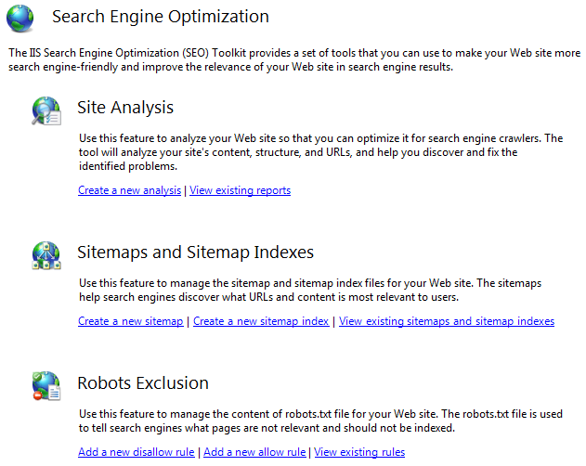
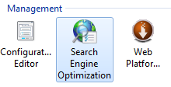
SEO Toolkit
www.iis.net /download/SEOToolkit
Notes:
Site Analysis – run a report and fix issues
Also consider using Google Page Speed or Yahoo! Yslow

Slide 42
SEO – Lower Case URLs
Requested URL: Matches the Pattern, Using: Regular Expressions, Pattern: [A-Z], Do not Ignore case
Match All conditions
Condition: {REQUEST_URI}, Type: Does Not Matches the Pattern, Pattern: ^/admin/*
Condition: {REQUEST_URI}, Type: Does Not Matches the Pattern, Pattern: ^/themes/*
Action type: Redirect, Action Properties: {ToLower:{URL}}, Append query string, Redirect type: Permanent (301)
Notes:
Bring up IIS URL Rewriter

Slide 43
SEO – Redirect www
Requested URL: Matches the Pattern, Using: Wildcards, Pattern: *, Ignore case
Condition: {HTTP_HOST}, Type: Matches the Pattern, Pattern: www.yoursite.com
Action type: Redirect, Action Properties: http://yoursite.com/{R:0}, Append query string, Redirect type: Permanent (301)

Slide 44
Contact Information
Geeks with Blogs - geekswithblogs.net/scottkuhl/
Twitter - @scottkuhl
Google - profiles.google.com/scottkuhl/
Email – scott@kuhl.ws
Deck and samples will be available on Geeks with Blogs

